Slide 1

Car rental Management System
TEAM 3

Slide 2
Overview
The journey
E-r diagram
Database code
testing
next steps
Overview

Slide 3
Problem Statement
When brainstorming this idea, we thought about how renting a car directly after a flight or to travel is often difficult as you are given a car without much say. We wanted to allow the user to be able to choose their vehicle size and the dates of pickup and return. With of course the ease of canceling if need be.

Slide 4
ABOUT
Our idea behind the car rental service was to create a database in which the user has various options behind the vehicle of their choice. Once a user sets their preferences and dates, they will receive a list of cars available to rent at that time if any are available.

Slide 5
THE JOURNEY
Week 1-2
Defined entities and relationships within the system (e.g., cars, employees, booking, Cancelled booking, calendar, etc.).
Developed entity-relationship diagrams (ERDs) to visualize data relationships.
Identified key attributes and data types for each entity.
WEEK 3-4
Database Schema Design:
Normalized database schema to minimize redundancy and improve data integrity.
Defined primary and foreign keys for relationships between entities.
Created tables with appropriate data types and constraints.
WEEK 5-6
User Interface Design:
Defined user roles and access levels for the system.
Sketched initial user interfaces for key functionalities (e.g., car search, booking, employee management).
Considered usability and accessibility principles for the interface.

Slide 6
THE JOURNEY
System Development:
Started implementing the system backend using a chosen database management system SSMS.
Developed functionalities for data creation, retrieval, update, and deletion.
Implemented basic validation and error handling mechanisms.
Week 7-8
Testing and Refinement:
Performed unit testing for individual modules and functionalities.
Conducted integration testing to ensure seamless data flow across the system.
Refactored code for efficiency and clarity based on testing results.
Continued user interface development and implemented additional features.
WEEK 9-10

Slide 7
Entities and relationships
ENTITIES
RELATIONSHIPS
Cars: CarID (Primary Key), CarName, Category
Employees: EmployeeID (Primary Key), EmployeeName, LoginID (Unique), PasswordHash
Bookings: BookingID (Identity, Primary Key), EmployeeID (Foreign Key), CarID (Foreign Key), BookingStartDate, BookingEndDate
Canceled Bookings: CancellationID (Identity, Primary Key), BookingID (Foreign Key), CancellationDate
Calendar: Date (Primary Key)
One Car can be booked in many Bookings. (One-to-Many)
One Employee can book many Cars. (One-to-Many)
One Booking can be canceled and moved to one CanceledBooking. (One-to-One)
One Date can have many Bookings. (One-to-Many)
*The LoginID of Employees is unique to prevent duplicate accounts.
*PasswordHash stores passwords securely using a hashing algorithm.
*The Manager role grants extensive permissions on Cars, Employees, and Bookings, and Employee1 is assigned to this role.

Slide 8
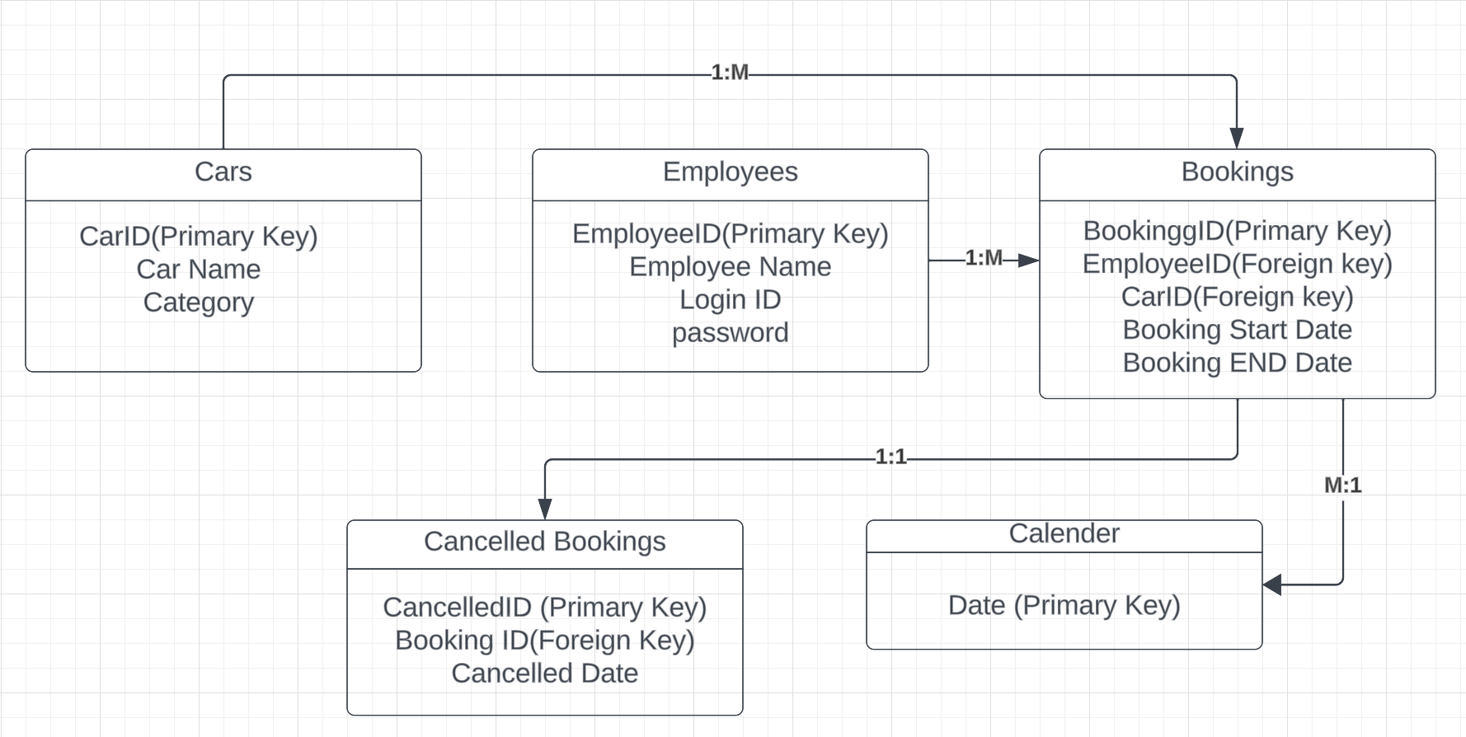
E-r diagram

Slide 9
Database code
USE CarRentalDB;
GO
-- Create Cars table
CREATE TABLE Cars (
CarID INT PRIMARY KEY,
CarName VARCHAR(50),
Category VARCHAR(20)
);
-- Insert data into Cars table
INSERT INTO Cars (CarID, CarName, Category) VALUES
(1, 'Car1', 'Sedan'),
(2, 'Car2', 'SUV'),
(3, 'Car3', 'Sedan'),
(4, 'Car4', 'SUV');
GO
-- Create Employees table
CREATE TABLE Employees (
EmployeeID INT PRIMARY KEY,
EmployeeName VARCHAR(50),
LoginID VARCHAR(50) UNIQUE,
PasswordHash VARBINARY(64)
);
-- Insert data into Employees table
INSERT INTO Employees (EmployeeID, EmployeeName, LoginID, PasswordHash) VALUES
(123, 'Employee1', 'emp1', HASHBYTES('SHA2_256', 'password1')),
(234, 'Employee2', 'emp2', HASHBYTES('SHA2_256', 'password2')),
(345, 'Employee3', 'emp3', HASHBYTES('SHA2_256', 'password3'));
GO
-- Create Bookings table
CREATE TABLE Bookings (
BookingID INT IDENTITY(1,1) PRIMARY KEY,
EmployeeID INT,
CarID INT,
BookingStartDate DATE,
BookingEndDate DATE,
FOREIGN KEY (EmployeeID) REFERENCES Employees(EmployeeID),
FOREIGN KEY (CarID) REFERENCES Cars(CarID)
);
GO
-- Create CanceledBookings table
CREATE TABLE CanceledBookings (
CancellationID INT IDENTITY(1,1) PRIMARY KEY,
BookingID INT,
CancellationDate DATE,
FOREIGN KEY (BookingID) REFERENCES Bookings(BookingID)
);
GO
-- Create Calendar table
CREATE TABLE Calendar (
Date DATE PRIMARY KEY
);
-- Populate Calendar table with dates
DECLARE @StartDate DATE = '2023-01-01';
DECLARE @EndDate DATE = '2024-12-31';
WHILE @StartDate <= @EndDate
BEGIN
INSERT INTO Calendar (Date) VALUES (@StartDate);
SET @StartDate = DATEADD(DAY, 1, @StartDate);
END;
GO
-- Create BookCar procedure
CREATE PROCEDURE BookCar
@EmployeeID INT,
@CarID INT,
@BookingStartDate DATE,
@BookingEndDate DATE
AS
BEGIN
-- Checking if the booking dates are valid
IF @BookingStartDate <= @BookingEndDate
BEGIN
-- Checking if the car is available for the specified dates
IF NOT EXISTS (
SELECT 1
FROM Bookings
WHERE @CarID = CarID
AND (
(@BookingStartDate BETWEEN BookingStartDate AND BookingEndDate)
OR (@BookingEndDate BETWEEN BookingStartDate AND BookingEndDate)
)
)
BEGIN
DECLARE @NewBookingID INT;
-- If the car is available, booking it and getting the new BookingID
INSERT INTO Bookings (EmployeeID, CarID, BookingStartDate, BookingEndDate)
VALUES (@EmployeeID, @CarID, @BookingStartDate, @BookingEndDate);
SET @NewBookingID = SCOPE_IDENTITY();
PRINT 'Booking successful. BookingID: ' + CAST(@NewBookingID AS VARCHAR(10));
END

Slide 10
Database code
ELSE
BEGIN
-- If the car is not available, raising an error
THROW 50000, 'Car not available for the specified dates.', 1;
END;
END
ELSE
BEGIN
-- If the dates are invalid, raising an error
THROW 50001, 'Invalid booking dates. Start date cannot be after end date.', 1;
END;
END;
GO
-- Create CancelBooking procedure
CREATE PROCEDURE CancelBooking
@BookingID INT
AS
BEGIN
-- Check if the booking exists
IF EXISTS (SELECT 1 FROM Bookings WHERE BookingID = @BookingID)
BEGIN
-- Move the booking to the CanceledBookings table
INSERT INTO CanceledBookings (BookingID, CancellationDate)
SELECT BookingID, GETDATE()
FROM Bookings
WHERE BookingID = @BookingID;
-- Delete the entry from the CanceledBookings table if it was successfully moved
IF @@ROWCOUNT > 0
BEGIN
-- Remove the reference from the CanceledBookings table
DELETE FROM CanceledBookings WHERE BookingID = @BookingID;
-- Delete the booking from the Bookings table
DELETE FROM Bookings WHERE BookingID = @BookingID;
PRINT 'Booking canceled successfully.';
END
ELSE
BEGIN
PRINT 'Error moving booking to CanceledBookings table.';
END
END
ELSE
BEGIN
PRINT 'Booking not found.';
END
END;
GO
-- Create AuthenticateEmployee procedure
CREATE PROCEDURE AuthenticateEmployee
@LoginID VARCHAR(50),
@Password VARCHAR(50)
AS
BEGIN
DECLARE @EmployeeID INT;
-- Checking employee credentials
SELECT @EmployeeID = EmployeeID
FROM Employees
WHERE LoginID = @LoginID AND PasswordHash = HASHBYTES('SHA2_256', @Password);
-- If valid credentials, return the EmployeeName
IF @EmployeeID IS NOT NULL
BEGIN
DECLARE @EmployeeName VARCHAR(50);
SELECT @EmployeeName = EmployeeName
FROM Employees
WHERE EmployeeID = @EmployeeID;
PRINT 'Login successful. Welcome, ' + @EmployeeName + '.';
END
ELSE
THROW 50000, 'Invalid login credentials.', 1;
END;

Slide 11
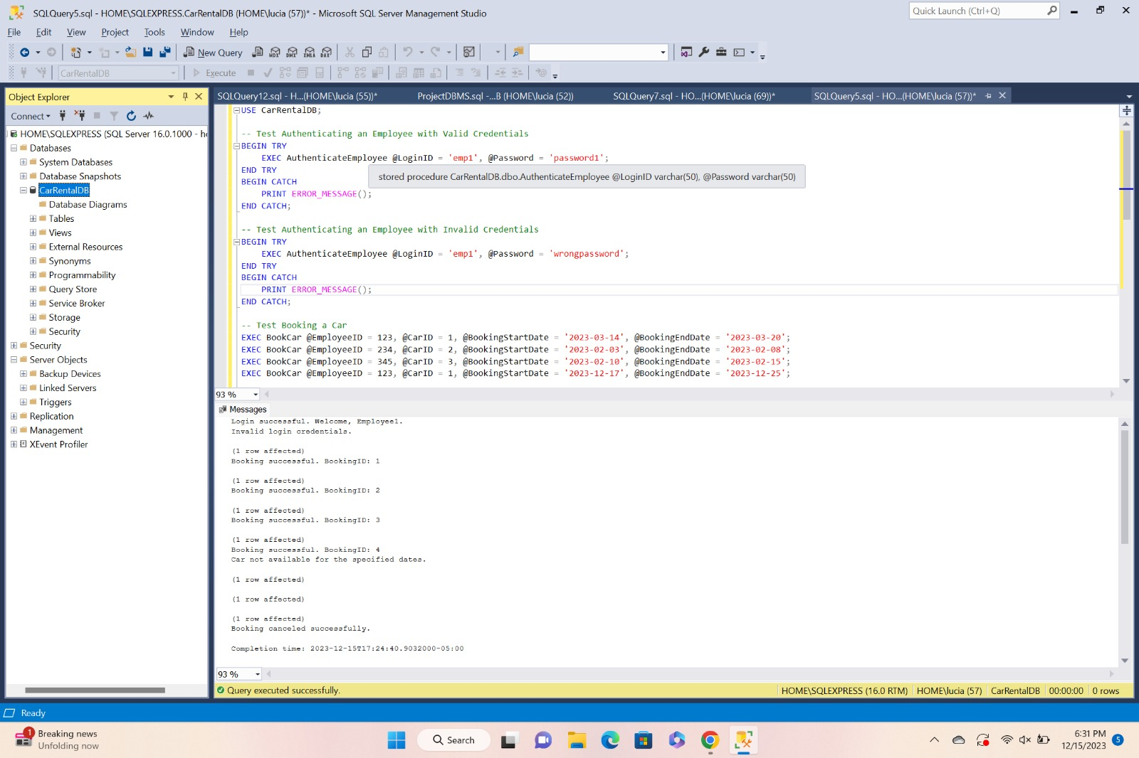
Testing

Slide 12
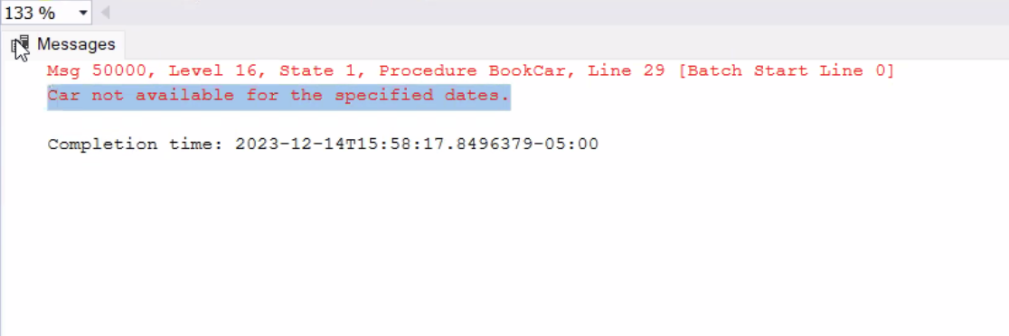
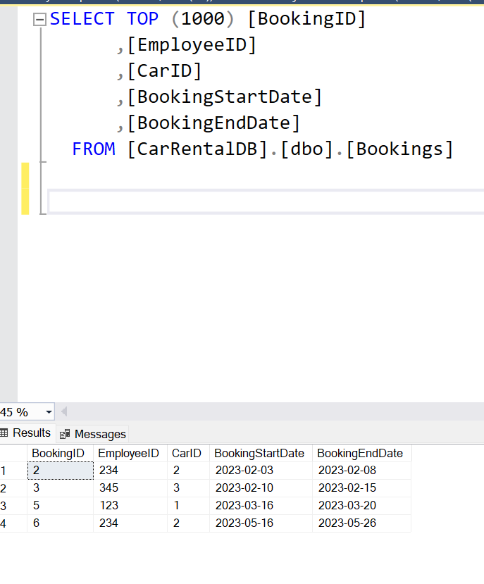
Testing

Slide 13
Next steps
Finalize user interface development and implement remaining features.
Conduct thorough system testing to identify and resolve any remaining bugs or errors.
Develop user manuals and training materials for system users.

Slide 14
SUMMARY
This code defines and creates the tables and procedures for a car rental database management system. It includes:
Tables:
Cars: Stores information about available vehicles (ID, name, category).
Employees: Stores employee details (ID, name, login, password hash).
Bookings: Tracks rentals (ID, employee ID, car ID, start/end dates).
CanceledBookings: Archives canceled rentals (ID, original booking ID, cancellation date).
Calendar: Holds all dates for potential bookings.
Procedures:
BookCar: Takes booking details and checks car availability. If valid, creates a new booking with an automatically generated ID.
CancelBooking: Checks if a booking exists and moves it to CanceledBookings, then deletes it from Bookings if successful.
AuthenticateEmployee: Verifies provided login credentials against the Employees table and returns the employee's name if successful.
Additional Notes:
Password hashes are stored securely to prevent unauthorized access.
Dates are validated to ensure booking start is before end.
Error messages are printed for invalid actions.
Overall, this code provides a functional framework for managing car bookings and employee access in a rental database system.
I hope this summary is helpful! Let me know if you have any other questions.

Slide 15
THANK YOU!
Raashil Aadhyanth
Luciano Tapia
Rushab Ramesh Vaza
Siddhesh Vijay Chavan

